Slide 1
YOUTUBE DL - GUI
Brandon Revels – Project manager
Coner Rawlings - documentation/Design
Sanjan Adhikari - frontend
Parker Mathis - backend
Taylor Bedefield - backend

Slide 2
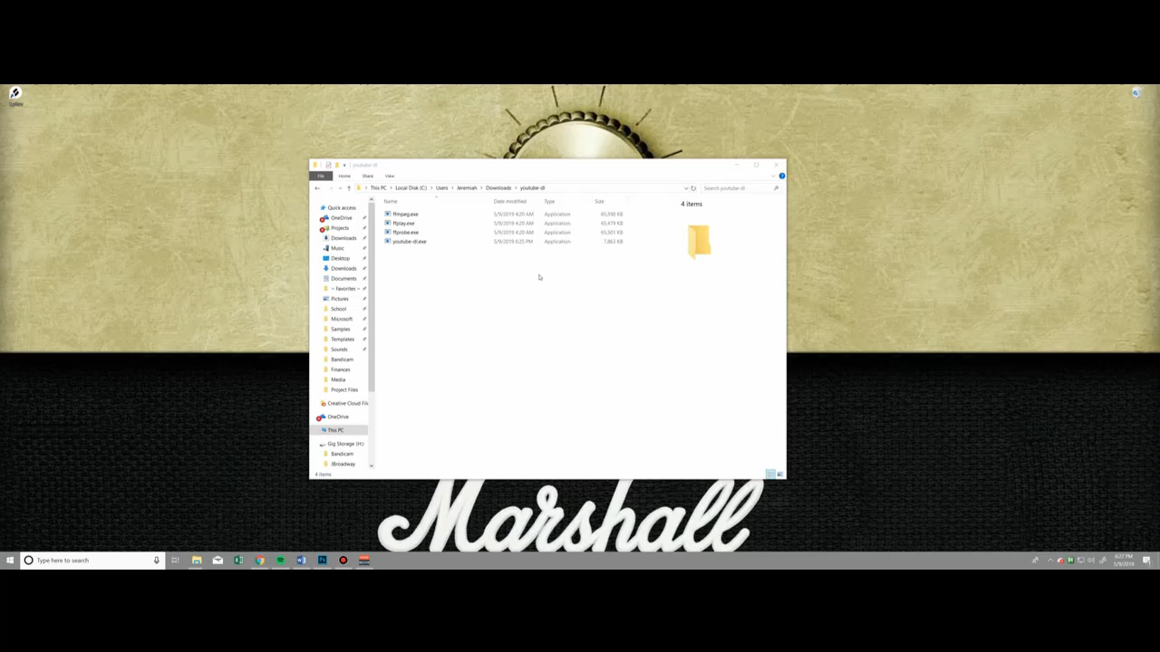

Slide 3

TABLE OF CONTENTS
INTRODUCTION
Youtube DL
Electron
BODY
PROPOSAL
PROGRESS REPORT
CONCLUSION

Slide 4
INTRODUCTION
Youtube-DL
Youtube-dl is a command line program to download videos from different websites
Electron
It is a open source framework developed and maintained by github
Combines the chromium rendering engine and the Node.Js runtime
Electron allows for the development of desktop GUI applications using web technologies

Slide 5
PROPOSAL
Create a modern, simplistic graphical user interface to the youtube-dl command line tool that will require minimal setup by the end user.
Interface will allow the downloading of at least YouTube, Instagram, and Twitter videos that are publicly accessible.
We plan to utilize the Electron.js desktop application framework to make our cross platform GUI interface.
Since Electron utilizes Node.js, we can use node modules to access the youtube-dl application from within our Electron app.

Slide 6
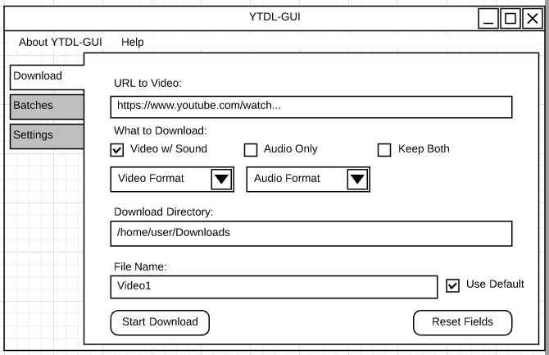
Sample of how we want our GUI to look like

Slide 7
MILESTONE
Basic GUI
Interface with Youtube-dl
Basic Functionality
Successfully download a video using the interface in Electron

Slide 8
PROGRESS
Installation of Electron and Youtube-dl
Basic Electron Boilerplate
Setup Github repositories
Mutual agreement of copyright

Slide 9
CONCLUSION
Youtube-dl and how it operates
Electron app
Design for the GUI
Communicate Electron and Youtube-dl

Slide 10

Questions?

Slide 11
REFERENCES PAGE
https://ytdl-org.github.io/youtube-dl/index.html
https://en.wikipedia.org/wiki/Electron_(software_framework)

